Slide 1
Multi-Facet Approach to Reduce Energy Consumption in Clouds and Grids: The GREEN-NET Framework
Passau, Germany, April 2010
Georges da Costa², Marcos Dias de Assunção¹, Jean-Patrick Gelas¹, Yiannis Georgiou³, Laurent Lefèvre¹, Anne-Cécile Orgerie¹, Jean-Marc Pierson², Olivier Richard³, Amal Sayah²
¹ INRIA RESO, ENS de Lyon
² IRIT, Université Paul Sabatier, Toulouse
³ MESCAL, Laboratoire ID-MAG, Grenoble

Slide 2
Introduction
Challenge of managing and providing resources to user applications
Server farms, Grids, data centres and Clouds
Grid’5000:
Experimental Grid composed of 9 sites distributed across France
OAR*: open-source Resource Management System (RMS) based on high-level components
Job types:
Advance reservations
Best-effort
* Nicolas Capit et al., A Batch Scheduler with High Level Components, 5th IEEE International Symposium on Cluster Computing and the Grid (CCGrid'05), pp. 776-783, May 2005

Slide 3
Introduction
Energy consumption of ICT
CO₂ footprint of Grids and Clouds
Existing hardware and cooling solutions
Improvements of the software stack
Forums and actions
Users’ awareness of energy consumption
OMG! That’s a lot!

Slide 4
The GREEN-NET Framework

Slide 5
Outline
Informing the users
Energy meters and interface library
Presenting energy consumption data
Involving the users
Power save mode of OAR
Autonomic energy aware support
Exploring idle resources
Predicting characteristics of advance reservations

Slide 6
Energy Meters
Power meter HAMEG HM8115-2
Used for calibrating other equipments
Omegawatt box
6 or 48 ports, communication via serial port
Deployed in three sites of Grid’5000 (162 nodes)
Lyon, Toulouse and Grenoble
One measurement per second
Heterogeneity of energy sensors

Slide 7
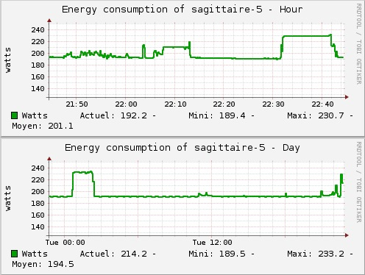
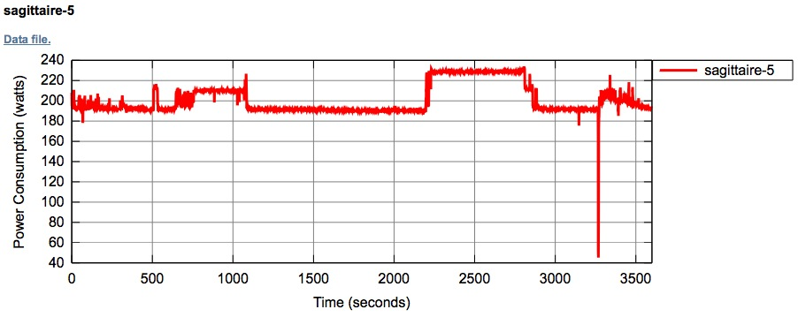
Collecting and Exposing Information
Library for interfacing with energy sensors
Client-side applications to obtain and store the energy consumption data
Applications to create graphs that display the energy consumed by equipments
Users can check how much energy their applications consume

Slide 8
Outline
Informing the users
Energy meters and interface library
Presenting energy consumption data
Involving the users
Power save mode of OAR
Autonomic energy aware support
Exploring idle resources
Predicting characteristics of advance reservations

Slide 9
The Power Save Mode of OAR
Power saving job type
It allows users to control the performance and power consumption of computing nodes during their jobs’ execution
CPU frequency scaling and hard-disk spin down
Support for other device types in future
Trade-off between energy savings and performance degradation

Slide 10
Experimental Scenario
Comparison among four cases:
Normal execution, HDD spin-down, CPU Freq., and CPU freq. + HDD spin-down
9 nodes Intel Xeon dual-CPU 2.5GHz QuadCore with 8GB of RAM
NAS NPB benchmarks
MPI 3.3 implementation and 64 processes

Slide 11
Experimental Results
Energy saving (%) / Performance gain (%)
Method | HDD Spin | CPU Freq. | HDD Spin + CPU Freq.
EP | 2.5 / 0 | 10.3 / -18.9 | 12.2 / -20.5
SP | 1.6 / 0.3 | 8.5 / -1.3 | 10.2 / -1.5
BT | 2 / -0.4 | 9 / -5.4 | 10.4 / -5.5
LU | 2.2 / 0.2 | 9.5 / -7.6 | 11.5 / -10.8
CG | 2 / -0.13 | 8.2 / -1.4 | 10 / -3.1
IS | 1.4 / 1.5 | 6.4 / -1.5 | 10 / -7.2
MG | 1.2 / -1.1 | 8.2 / -0.5 | 9.8 / -3.4
Overall | 1.8 / 0.05 | 8.5 / -5.2 | 10.5 / -7.4

Slide 12
Outline
Informing the users
Energy meters and interface library
Presenting energy consumption data
Involving the users
Power save mode of OAR
Autonomic energy aware support
Exploring idle resources
Predicting characteristics of advance reservations

Slide 13
Exploring Idle Periods
Time_last_res_finished
Current time
Time_last_res_starts
Time
Idle_time
Sleep_time
Green management algorithm:
Node sleep:
IF Idle_time > Node_manager_idle_time AND Sleep_time > Node_manager_sleep_time THEN
Exec Node_sleep_cmd
Node wake up:
IF sleeping node is needed THEN
Exec Node_wakeup_cmd
Parameters:
Node_manager_idle_time = 600 seconds
Node_manager_sleep_time = 600 seconds
Node_sleep_cmd = PowerOFF script
Node_wakeup_cmd = PowerON script

Slide 14
Experimental Scenario
Traces from DAS-2 clusters
32 nodes
Resource utilisations of 50.32% and 89.62%
Durations of 7.25 and 7 hours
Management modes:
Normal
Green
Deployment of OAR on 33 nodes
1 master node and 32 workers

Slide 15
Energy Consumption: 50.32% resource utilisation

Slide 16
Energy Consumption: 89.62% resource utilisation

Slide 17
Experimental Results
Experiments
Parameters | 1 | 2 | 3 | 4
Management mode | Normal | Green | Normal | Green
System utilisation (%) | 50.32 |  | 89.62
Total number of jobs | 309 |  | 188
Duration of traces (H) | 7.25 |  | 7
Energy consumed (KWh) | 42.7 | 30.6 | 40.7 | 36.6
Average energy consumed (KW) | 5.9 | 4.2 | 5.8 | 5.2
Average job waiting time (seconds) | 8 | 829 | 1 | 218

Slide 18
Predicting the Next Reservation
Next reservation R_{e} = (l_{e}, n_{e}, t_{e})
Method 1: At time t, the estimated start time of R_{e} is the average of the arrival of reservations after time of the day t on:
The two previous days
The same weekday of the previous week
i.e. t_{e} = 1/3 [t_{t,j-1} + t_{t,j-2} + t_{t,j-7}] + t_feedback
Method 2: Average of characteristics of 5 previous reservations
Logs of advance reservation requests
Length or duration
Number of nodes
Start time

Slide 19
GreenNet Policies
User: always obeys the user’s demands
Fully-green: uses the solution that saves the most energy
**%-green: handles ** of requests, taken at random, with the fully-green scheme and the rest with the user policy
Deadline: uses the fully-green approach if it does not delay the request for more than 24h of the start time required by the user

Slide 20
Experimental Results
Replay of Grid’5000 logs

Slide 21
Conclusions and Future Work
The GREEN-NET Framework
Informing users, involving users, and autonomic energy-aware resource management
Power save mode of OAR
Switching off unused resources
Predicting the characteristics of reservations
Analysis of energy consumption logs
Network equipments and protocols
Virtualisation technologies

Slide 22
Thank you!
Questions & Answers

